Slide 1

Montly Meeting
02/04/2024

Slide 2
Content
Road Map
Reserach Gap
Research Proposal
Future Work
09-10-2020

Slide 3
Roadmap
09-10-2020

Slide 4
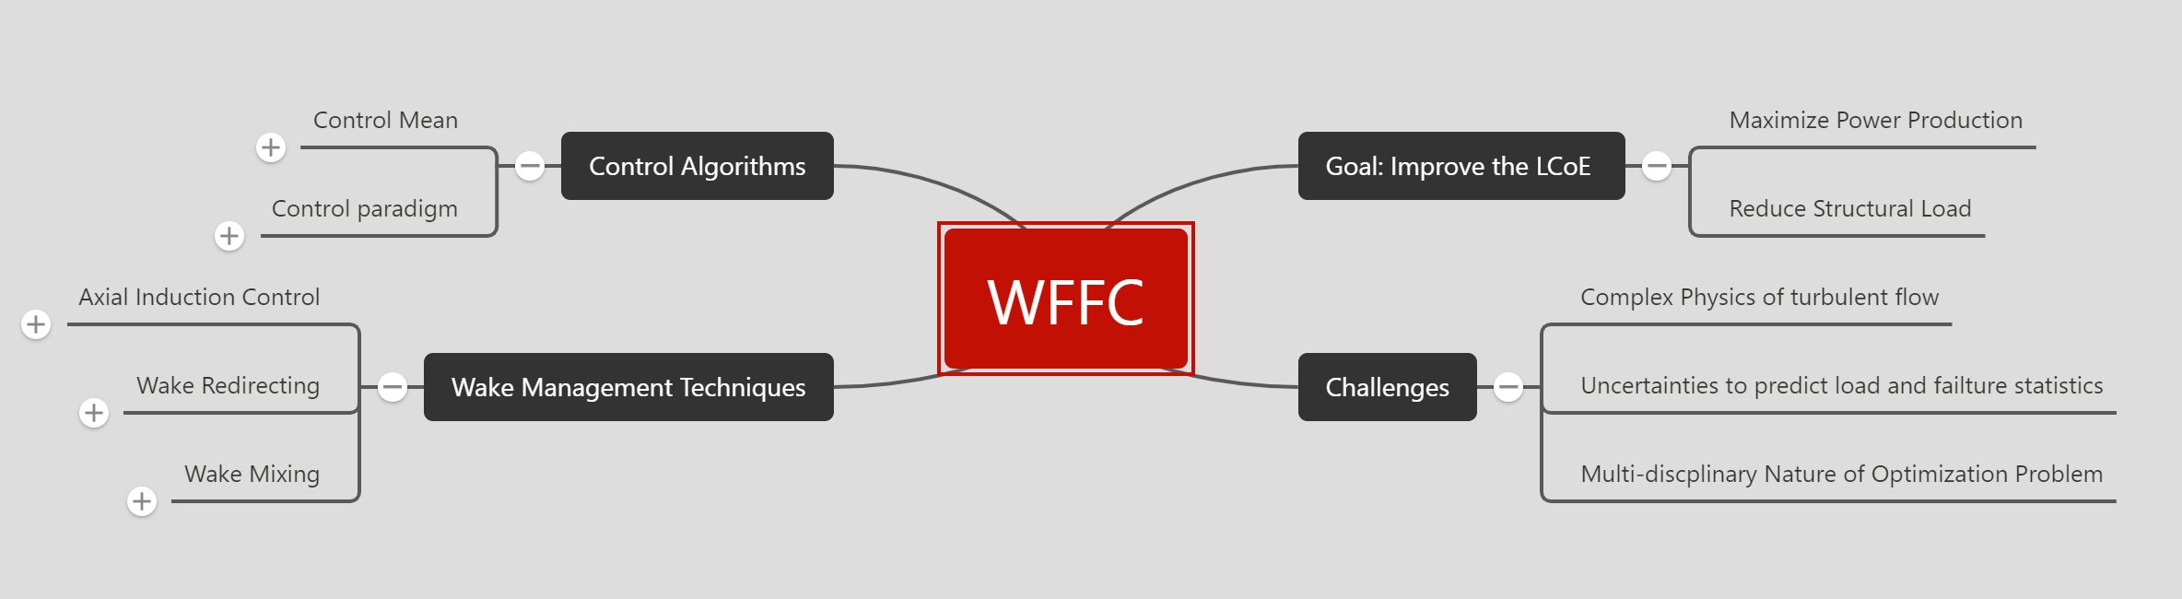

Slide 5
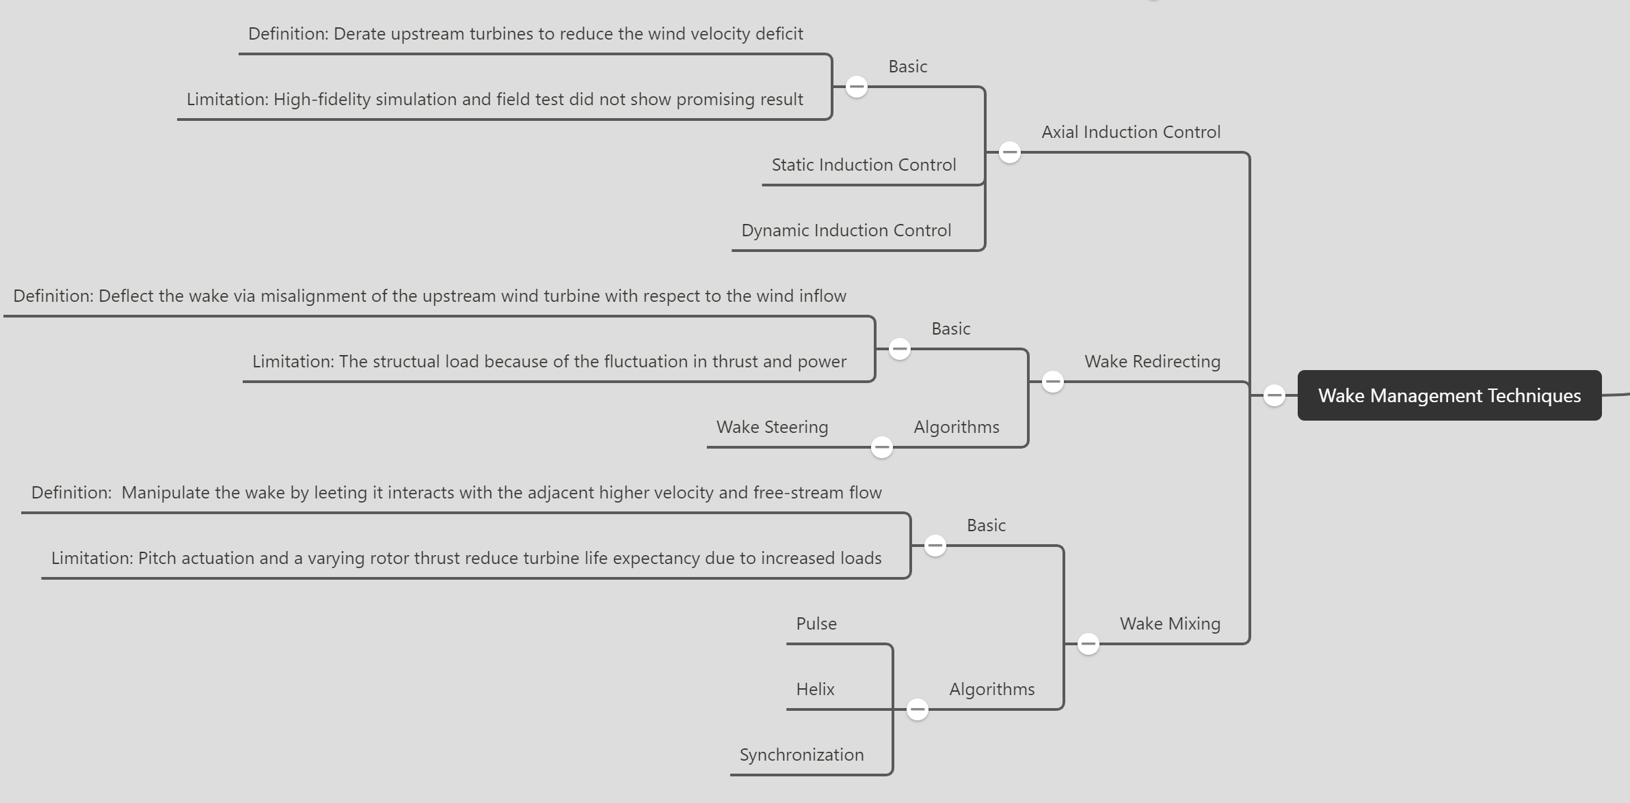

Slide 6
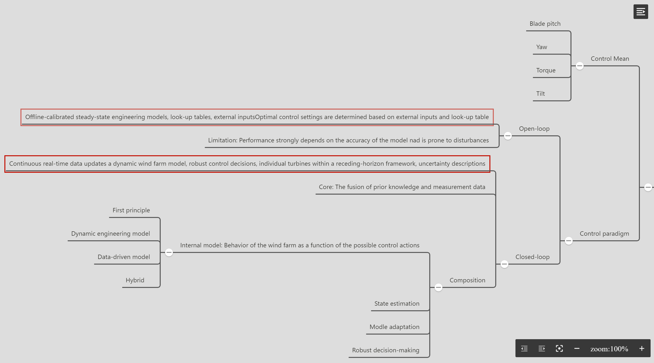

Slide 7
Research Gap
09-10-2020

Slide 8




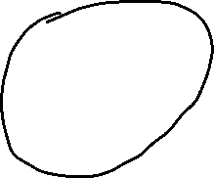
AIC
Wake Management
Wind Farm
Wake Effect
Wake Redirection
Wake Mixing
CL Control
Real-time update Internal Model
Helix
Phase Synchronization
Interaction between turbine

Slide 9
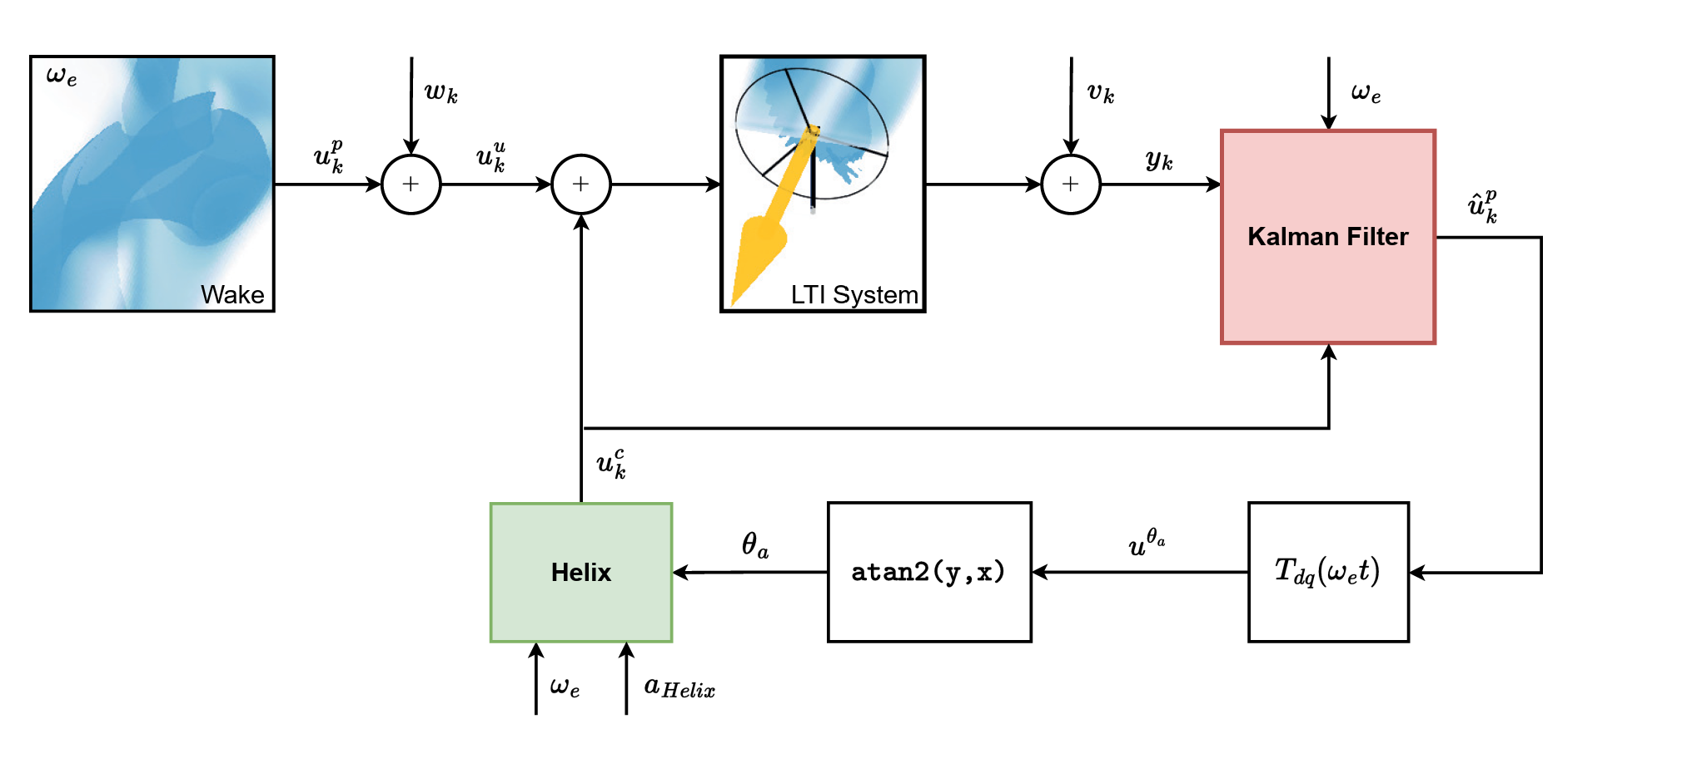
Control action is obtained by known frequency, first principle(Helix) and blade blending moment.

Slide 10
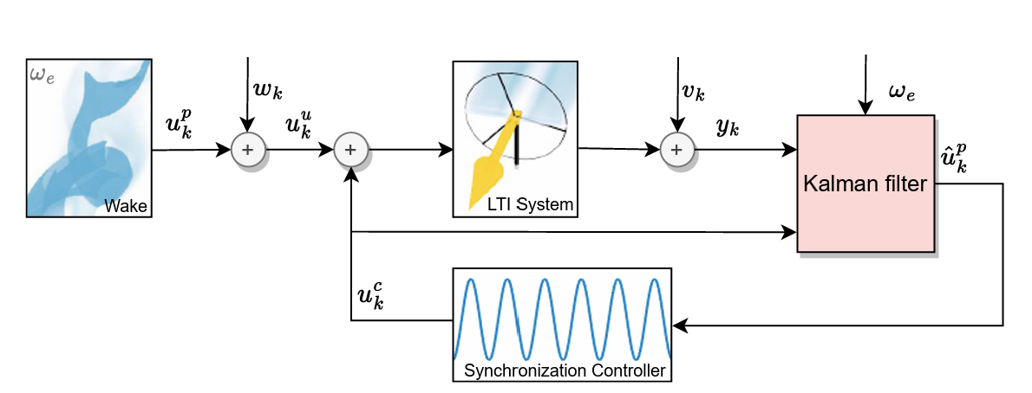
Control action is obtained by known frequency, synchronization controller input and blade blending moment.

Slide 11
Improvements:
the helix method can be initiated with less pitch actuation in a downstream WT
More power production

Slide 12
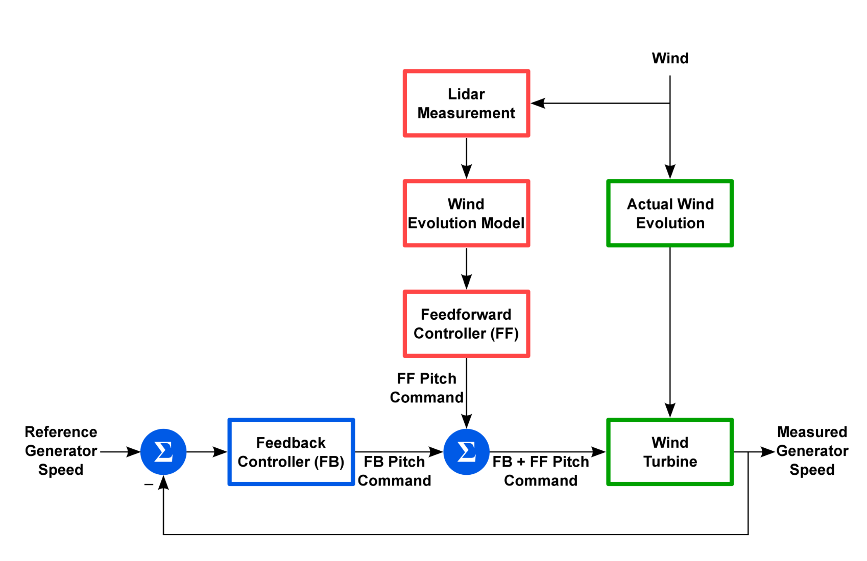
Example of using LIDAR for feedforward and feedback control (for Collective Pitch Control)

Slide 13
Result:
The LIDAR feed-forward controller takes over some of the low-frequency speed regulation duty, so the PI controller can be reoptimized by reducing gain such that the speed control is still good but a reduction in pitch activity and thrust-related load.

Slide 14
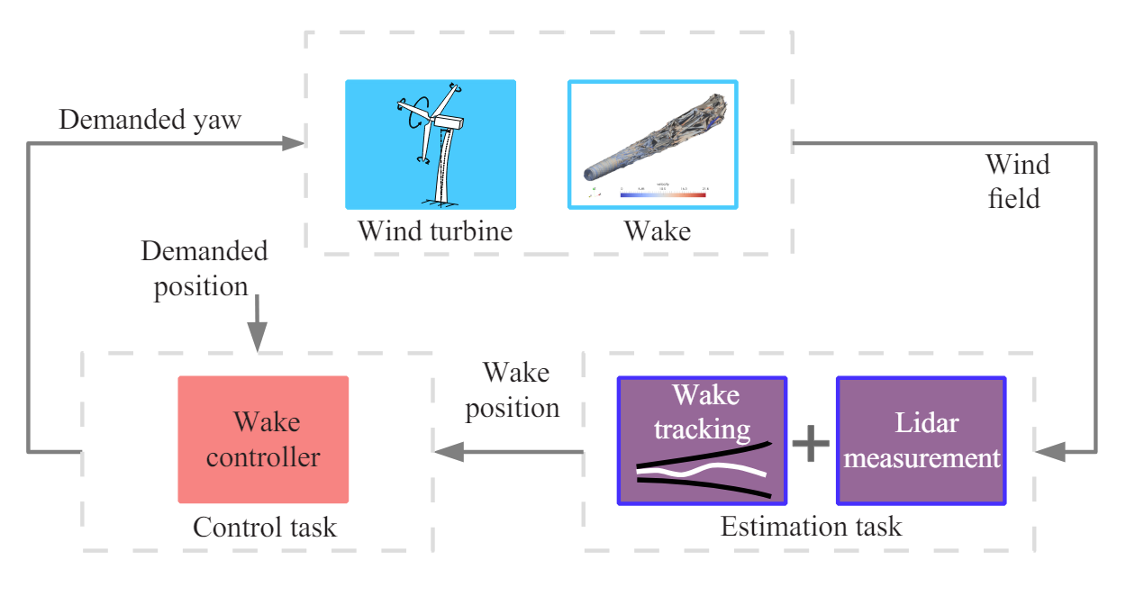
Example of using LIDAR for yaw control

Slide 15
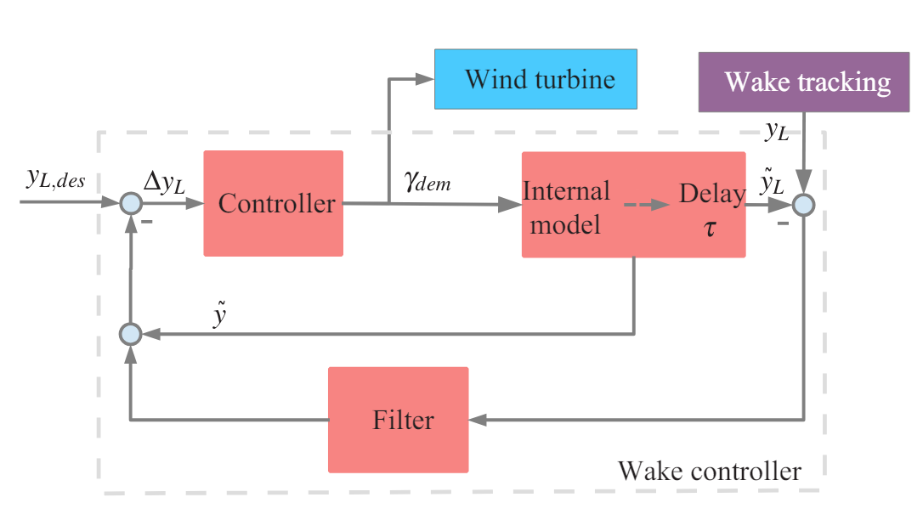
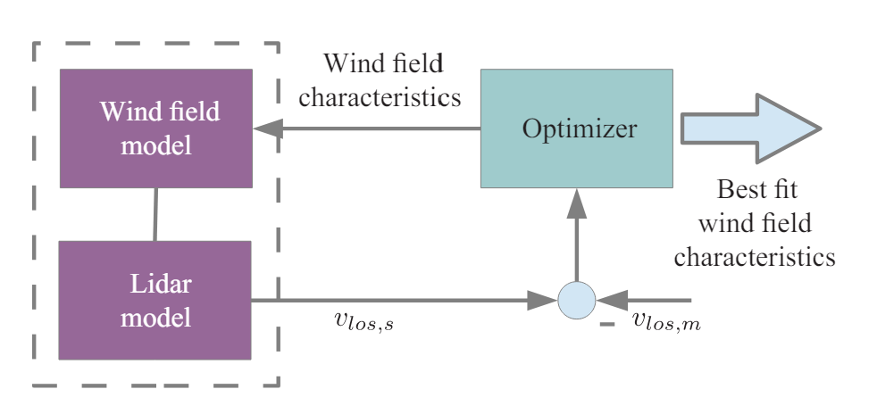

Slide 16
Research gap:
 | Current | Gap
Phase Synchronization | The key to achieve synchronization is to the phase info, to get that, a Kalman filter is used to estimate the incoming periodic signal’s phase based on WT output (blade blending moment) Helix frequency (assume known) Controller inputs | Using a Kalman filter means: Need to develop model for the WT Indirect measurement Only appropriate for one frequency, lack the flexibility Load
Data-driven Modeling | Modeling method, e.g. DMD, needs simulation first to get data, and then modelling is performed | In real-engineering scenario, simulation data is not accessible
LIDAR (IPC) | LIDAR based feedforward technique is used for collective pitch control or individual pitch control to mitigate load; Use LIDAR to reconstruct wake for yaw control | LIDAR application for wake mixing hasn’t been studied yet, as well as the application of lookahead information or rea-time data processing pipeline of wind to the synchronization

Slide 17
Research Proposal
09-10-2020

Slide 18
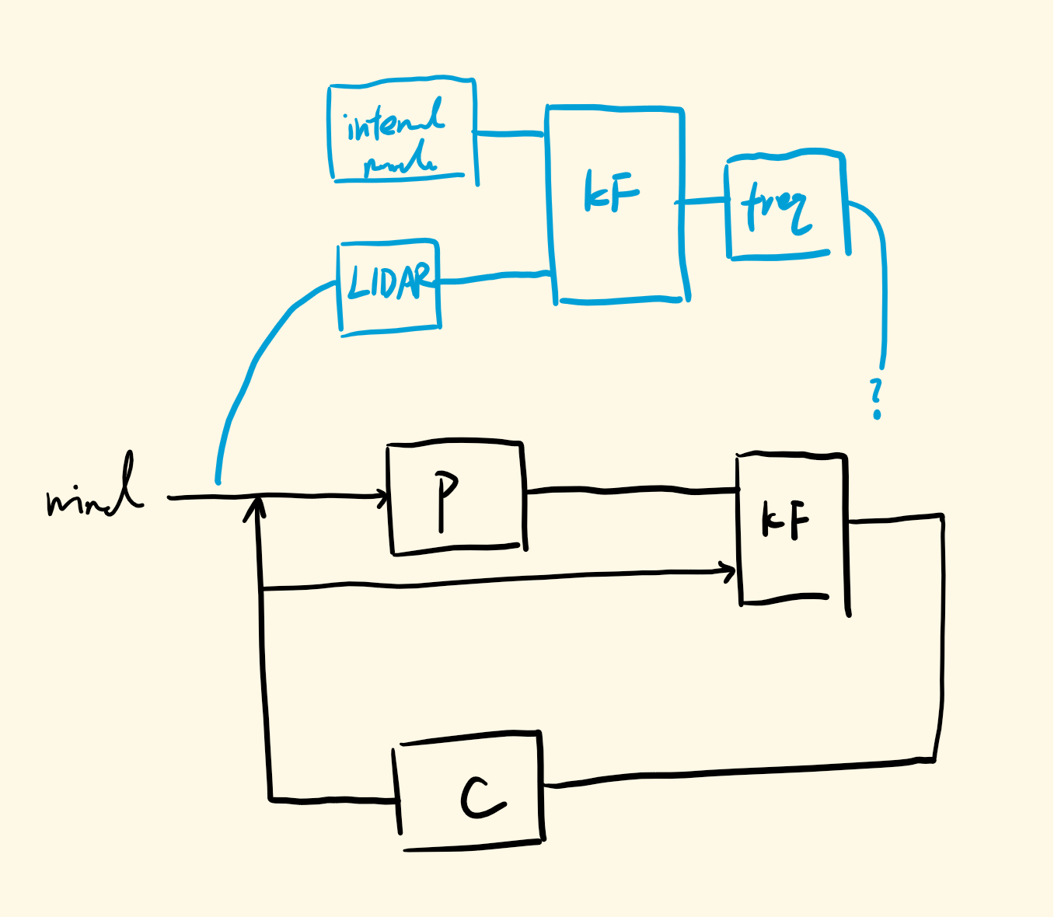
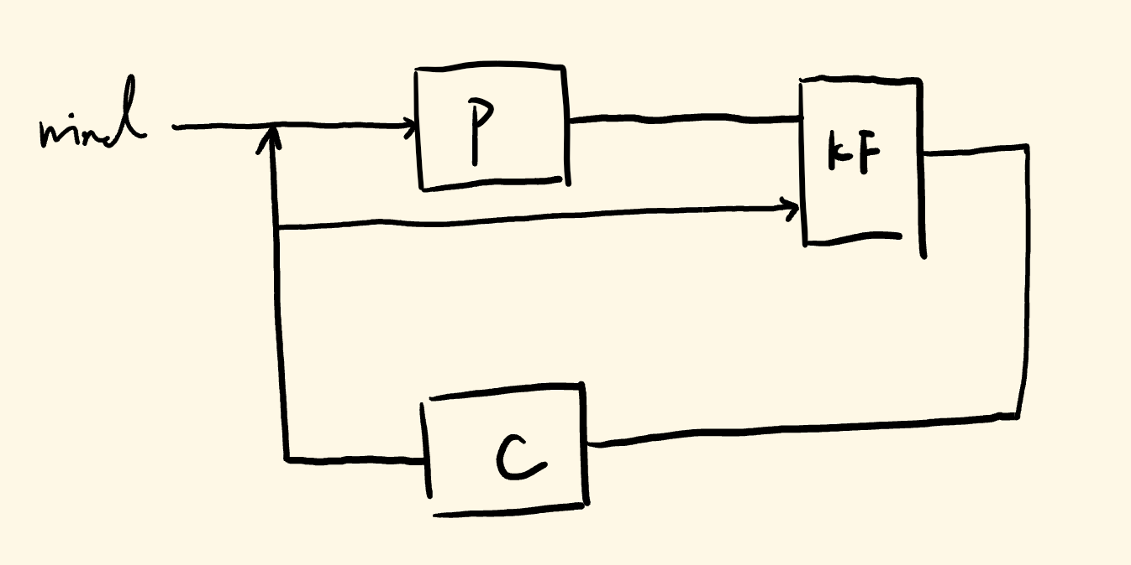
Research proposal:
Lidar/Lookahead Information enhanced Real-time Wind Farm Control through Helix Approach and Phase Synchronization
Notes:
Great potential: phase synchronization, multi-frequency wake mixing

Slide 19
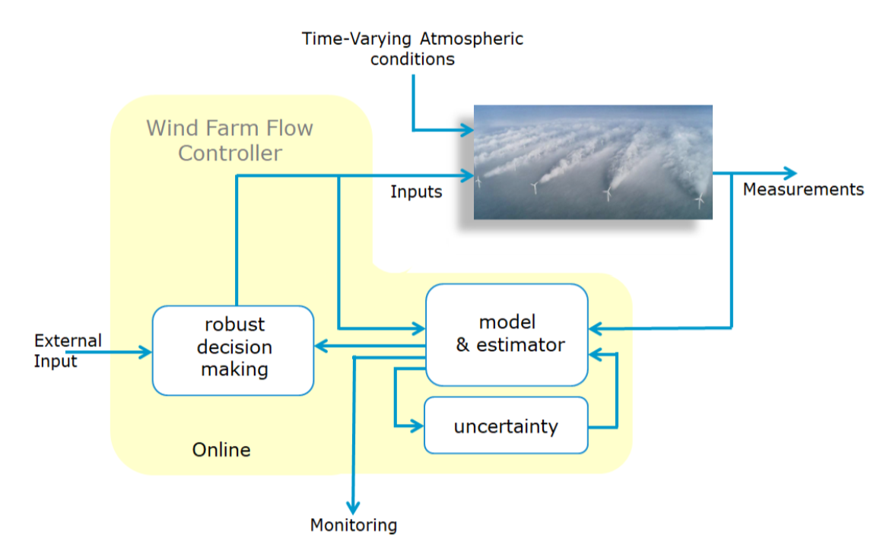


Slide 20
Research questions
How to use the lookahead wind information acquired by LIDAR to enhance phase synchronizaiton using helix approach for the wind farm?
How to reconstruct the helix wake based on LIDAR? (model adaptation)
How to make it fast enough for real-time construction?
What are some important frequency features for phase synchronization?
How to integrate the LIDAR with control? (feedforward for load reduction, feedback for power maximization)
09-10-2020

Slide 21
Future Work
09-10-2020

Slide 22
Literature Review
Software Learning (IEA 15 MW, LIDAR, OpenFAST)
Helix reconstruction
Internal model selection
Fusion filter selection
LIDAR uncertainty handling
Control integration
Diagram design
Optimization for reconstruction method

Slide 23
Thanks & Feedback

